Slide 1
Statistical Learning-Final Project

Slide 2

Define the Question
Which model can best predict whether an image is a ship or a frog?
Notes:
Given the CIFAR 10 image dataset, we opted to create a binary classification set to identify whether an image correctly classified a frog or a ship. Our assumption was that because most are likely photographed in the water, their shapes could potentially become distorted (most likely pentagonal). We’ll explore this more on the next slide,

Slide 3
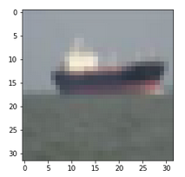
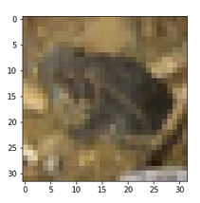
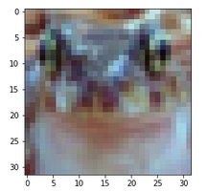
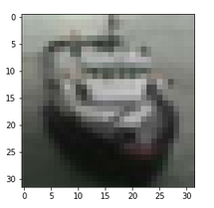
Exploratory Data Analysis
Shapes
Are there defining shapes for each?
Can they be confused for similar shapes in the other images?
Colors
This assignment is more interesting with colors included.

Slide 4
Preprocessing
2.
Relabel data
4.
6.
Scale the data
Add ConfigProto()
Convert response to 1D
3.
5.
1.
Convert data to input and output test, training, and validation sets
Reduce variable dimensions using PCA
Notes:
To evaluate the different machine learning methodologies used in class, we initially relabeled converted out dataset to reflect whether an object was 1, a ship or 0, a frog. We then broke the dataset into training, test, and validation sets with a 50%, 25%, and 25% respectively.

Slide 5
K-Nearest-Neighbors (KNN)
Standard KNN
knn.fit(X_train, y_train)
No K designation
Optimized KNN
GridSearchCV() with K between 3 and 7
Optimized at K=3
Accuracy: 0.912
Accuracy: 0.914
Notes:
For our initial K-Nearest-Neighbors, we fitted the base knn() function in Python with our training set. Using this model to predict the test responses, the model was fairly effective and was able to predict the results with 91.2% accuracy.
To optimize this model, we utilized the GridSearchCV() function and designating each k between 3 and 7. This was able to marginally improve our model to 91.4% accuracy, slightly higher than the accuracy of the standard knn() function.

Slide 6
Random Forest
Standard Random Forest
rf.fit(X_train, y_train)
No tree or depth designations
Optimized Random Forest
GridSearchCV()
Trees of 200, 300, or 400
Depths of 9, 10, 11
Optimized at 300 Trees and a depth of 11
Accuracy: 0.927
Accuracy: 0.931

Slide 7
Gradient Boosting
Standard Gradient Boosting
gb.fit(X_train, y_train)
No tree or learning rate designations
Optimized Gradient Boosting
GridSearchCV()
Trees of 200 or 300
Learning rate of 0.05, 0.1, or 0.2
Optimized at
Accuracy: 0.928
Accuracy: 0.934

Slide 8
Neural Network
Standard Neural Network
Sequential()
Three hidden layers with 50, 10, and 10 neurons each
Optimized Neural Network
Sequential()
Hidden layer with 100 neurons
Dropout layer with rate of 0.5
Hidden layer with 25 neurons
Dropout layer with rate of 0.5
Accuracy: 0.934
Accuracy: 0.938

Slide 9
Convolutional Neural Network (CNN)
Standard CNN
Sequential()
Convolution layer with 16 neurons and kernel size of 3
Pooling layer with 2 strides
Output layer with 1 node
Epoch of 20, batch size of 10
Optimized CNN
Repeated standard CNN 3x
Changed neurons to 64, 128, and 32
Increased strides to (2,1) in layers 1 and 2, then 4 in 3
Epoch of 20, batch size of 200
Accuracy: 0.951
Accuracy: 0.964

Slide 10
Model Comparisons and Conclusion
Optimizing provided improvements but not significant improvements (CNN excluded)
CNN was the most effective model
Validation accuracy was very close to training accuracy
Some concern regarding the MSE and Model Loss, which may lead to future work on the model

